Slide 1
Modularized Robotic Arm
Team 15
Fuhua Song
Kevin Bradshaw
Yuan Tian
Zhengshuai Zhang
Feb 26, 2016

Slide 2
ICD Presentation Outline
System Interfaces
Physical Components Overview
Electrical System Overview
Subsystem Interfaces
Robotic Arm
Kinect Control
Wireless Communication
Camera Interface
Hand Tools Integration
Notes:
Mechanic Arm System ( load size, # of tools integrated, size, rotation speed, degree of freedom)
Wireless communication system (Data speed, distance)
Power system ( power consumption, heat generated, last time)
kinect Arm Projection Sampling System ( FPS, lag time, recognition ability)

Slide 3
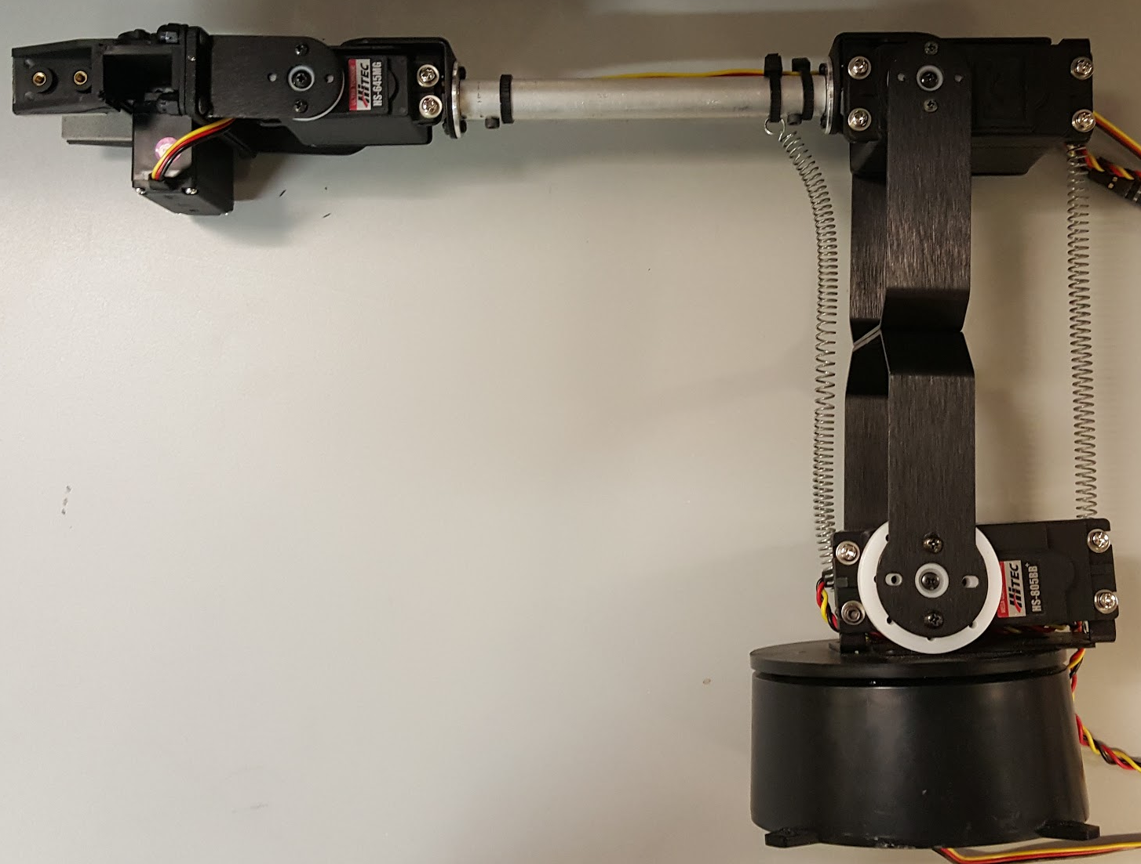
Physical Components Overview
Robotic Arm
Weight: 1.6 lbs.
LxWxH: 19”x2”x4”
Max weight: 3 lbs.
Max LxWxH: 26”2”x4”
Robotic Arm
5 Servo Motors
PWM Driver
Raspberry Pi 2
Wireless Module
Power Supply
Laptop
Kinect
Wireless Module
Modularized Tools
Sensors
Hand Controller
Feedback Sensors

Slide 4
Electrical System Overview
User
Kinect
Laptop
RF Module
Hand Controller
Robotic Arm
5 Servo Motors
16-Channel, 12-Bit PWM Driver
Raspberry Pi 2
Modularized Tools
Sensors
External Power Supply

Slide 5
Robotic Arm
PWM
Servo Motor 1
Shoulder
V+
16-Channel, 12-Bit PWM Driver
J1 GND
J2 OE
J3 SCL
J4 SDA
J5 VCC
J6 V+
PCA9685A
Input 2.3 - 5.5 V
GND
Raspberry Pi 2
GND J9
GND J6
GPIO3 J5
GPIO2 J3
5V J2
GND J20
Servo Motor 2
Shoulder
Servo Motor 3
Elbow
Servo Motor 4
Wrist
Servo Motor 5
Wrist
5V External Power Supply
Notes:
OE = Output Enable
SCL = Serial Clock Line
SDA = Serial Data Line

Slide 6

Kinect Control
Raspberry Pi
User
Maximum Sampling Rate: 30 FPS
Default Operation Range: 2.6 ft - 13 ft
Maximum Resolution: 1. Color: 640*480
2. Depth: 320*240
Infrared Rays
Digital over USB
Laptop
Kinect
Notes:
Use color-coded arrows or ellipses to highlight the Mechanical, Electrical and Thermal Interfaces of SUB-System4. DO NOT change the color-coding of SUB-System4 Functional Block Diagram (if possible).

Slide 7
Wireless Communication
Arm
Camera Interface
Kinect
Sensor
User Glove
USB Serial
Digital
Digital
Digital
Camera Serial
Interface
Laptop
Raspberry Pi 2
Arduino Duo
Operation: USB Transmitter/Receiver with antenna via Wifi
Constraints: Lag Time, Synchronization, Integration
Notes:
Use color-coded arrows or ellipses to highlight the Mechanical, Electrical and Thermal Interfaces of SUB-System1. DO NOT change the color-coding of SUB-System1 Functional Block Diagram (if possible).

Slide 8
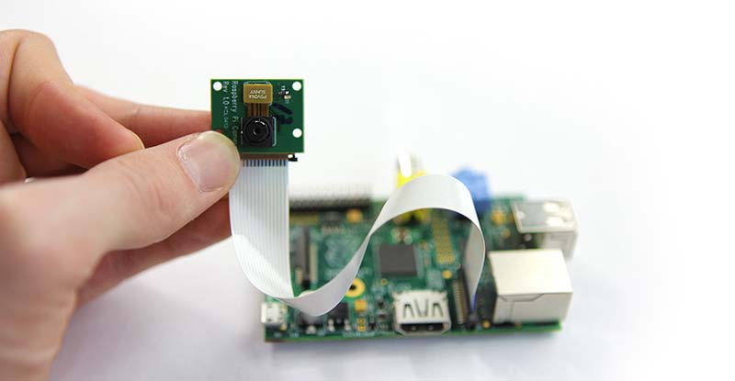
Camera Interface
Miniature Camera
Raspberry Pi 2
Laptop
Camera: Connected to CSI linked to Raspberry Pi 2 GPU send back to computer
Constraint: Latency is primary concern due to visual processing
Resolution: 380 lines
Operation Range:150-foot
Output Frequency: 2.45GHz
Power Supply: 9V Battery
Notes:
Use color-coded arrows or ellipses to highlight the Mechanical, Electrical and Thermal Interfaces of SUB-System2. DO NOT change the color-coding of SUB-System2 Functional Block Diagram (if possible).

Slide 9
Hand/Tools Integration
Touch
Sensors
Raspberry Pi 2
Laptop
12 bit Receiver RF Module
Motor Drive
Tool Motor
12 bit Transmitter RF
Module
Encoder
DPDT Switches
User
Sensors (typical data values):
Digital Value Resolution: 11 bits - 14 bits
Power Supply: 6 V
Current Supply: ~200 uA
Notes:
Use color-coded arrows or ellipses to highlight the Mechanical, Electrical and Thermal Interfaces of SUB-System3. DO NOT change the color-coding of SUB-System3 Functional Block Diagram (if possible).

Slide 10
Conclusion
System Interfaces
Kinect 1 vs. Kinect 2
Real time arm movement
Wireless Communication
Subsystem Interfaces
Modularized tool applications
Mechanical Constraints
Thank You!

